Slide 1
Databases

Slide 2
What’s a Database?
At a high-level, here are some ways to think about databases (there are more) – the data must have some (even if flexible) structure assumption, must be stored in some location or series of locations with a method to submit an inquiry and process a result
Structuring of Data
Storing Data
Inquiry / Processing Data
Tabular form with rows and columns
Key-value pairs
Document
Graphs
Hierarchical / Tree
Large Column
On a single computer
Across several computers
Within a single intranet or data cluster
Through the internet across many disparate computers
Backup
Fault Tolerant?
Multiple access
Consistency
Etc.
This will depend on the structure and storage of the data (and potential on the parallelism of the processing too)
Relational algebra
SQL
MapReduce
Other types of inquiry / processing methods
VAI | Value Add Insights © 2014

Slide 3
Database Design
Grid
NoSQL
Internet
MapReduce Parallel and distributed
Data –
Parallel
Search Key Lookup
Analytics
Shared
Memory
Older DBs
High Performance
Private data center
Latency
Throughput
MySQL
ProtegeSQL
Etc.
Ref - by Michael Isard at Microsoft Research
VAI | Value Add Insights © 2014

Slide 4
Database Structures
Others
Relational
Distributed + Parallel
NoSQL
Examples: MySQL, SQL Server,
Oracle
Description: a database structured to recognize relations among stored items of information usually with a defined schema
Key Characteristics: Relational Algebra, Physical / logical independence, *“forced to be clean”
When do you use:
Examples: Hadoop, Teradata
Description: Data is distributed across a set of nodes and processing is performed in parallel
Key Characteristics: Scalable, Fault Tolerance (during processing), “no loading”, bring operations to data.
When do you use: Massive data, capable or real time, long and complicated calculating and processing, unstructured
Examples: MongoDB, CouchDB, Vertica, Cassandra and many others
Description: Storage and retrieval of data in alternative form to traditional relational data (row and column), data can be stored in many ways aimed at solving particular problem: column, document, key-value, graph and others
Key Characteristics: scalable, some search and retrieval is faster, finer control of data consistency
When do you use: Real time web applications and large data sets, unstructured
VAI | Value Add Insights © 2014

Slide 5
More on Distributed Systems
Distributed Query
Parallel Query
What happens during the query:
“Rewrite” the query as a union of subqueries
Workers communicate through standard interfaces, so compatible with federated, heterogeneous, or distributed databases
In other words – data is distributed, we do a series of steps to find what we want, assimilate it together and reduce it down to our result
Buzz word: Map Reduce
Example: Hadoop – an open source distributed database system from Apache with a million extensions.
What happens during the query
Each operator is implemented with a parallel algorithm
Algorithm gets run on each “AMP” or server and results are returned
In other words – data is distributed, but more importantly, so is the “query”. It is run separately on each computer and results are returned and then aggregated.
Buzzword: Hash buckets & IDs
Example: Teradata – a powerful proprietary distributed and parallel processing database.
In a nutshell, Hadoop is excellent for storing unstructured data and running parallel transformations to 'sanitize' incoming data, where Teradata / RDBMSs (Relational Database Management System) excel at executing complex queries quickly. Though there are extensions and methods to improve Hadoop’s performance on large complex queries, it is best for ingestion, storing, filtering and aggregating.
VAI | Value Add Insights © 2014

Slide 6
Some Well Known Extensions of Hadoop
Pig Relational Algebra
Hive SQL over Hadoop
Impala, SQL over HDFS uses some Hive code, newer and Cloudera specific
Apache
Ambari
Cloudera
Hortonworks
Web browser management
Hue
Ambari
Flume
Pig
Hive
Web browser management
Collect, aggregate and move large amounts of data
Other big Player in Hadoop world offering enterprise support and solutions for Hadoop
Pig Latin – MapReduce translator
SQL emulator
Impala
Kafka
MapReduce
YARN
SQL emulator
Publish-subscribe for large amounts of streaming data
“Yet-Another-Resource-Negotiator” – a more generalized method for writing arbitrary distributed processes
Programming model for large distributed and parallel data sets
Spark
Fast, in-mem alternative to MapReduce
Hadoop
Others
Node
Node
Node
HDFS
HDFS
HDFS
HDFS
HDFS
HDFS
https://hadoopecosystemtable.github.io/
VAI | Value Add Insights © 2014

Slide 7
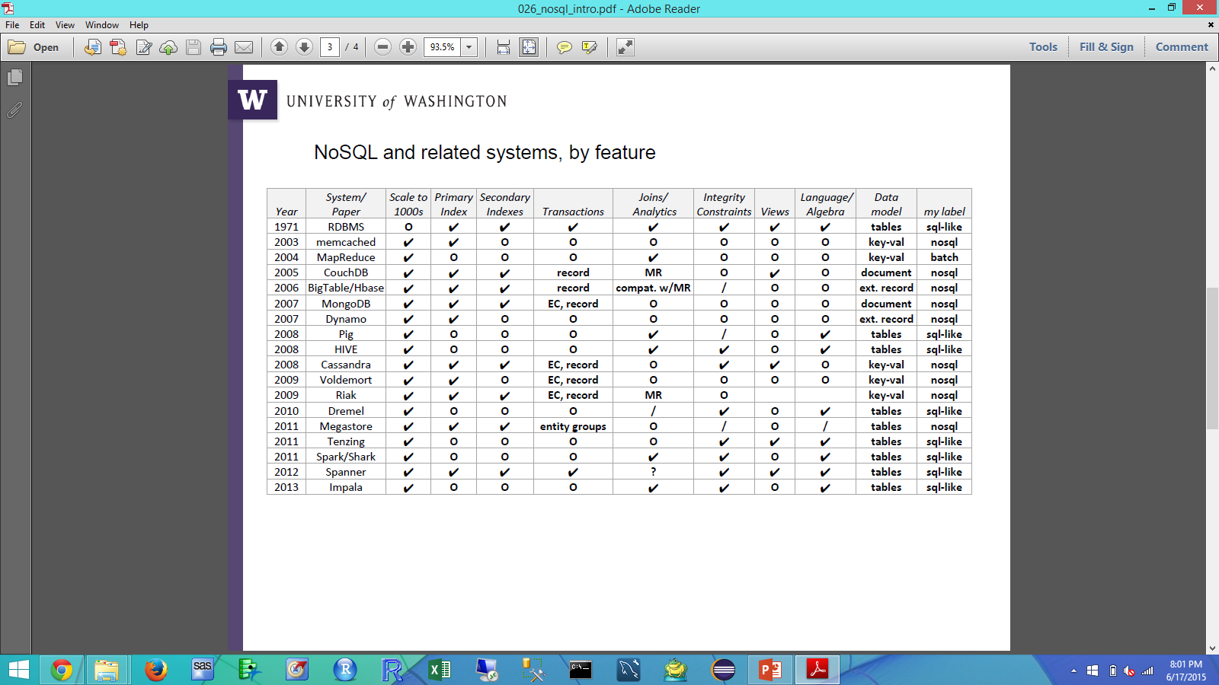
High level survey of a selection of databases
Ref – Bill Howe, University of Washington
VAI | Value Add Insights © 2014

Slide 8
Enterprise Data Ecosystem – High level DMU
Self Serving Business User
Analysts supporting Insights
Access layer
Useful
Primary access point for analysis
Data Scientist
Data Access & Extraction
BI Tool Interface
Connectivity by other tools
Filtered, Aggregated or “conforming”
By choice or not, often must leverage all layers of the ecosystem to answer the business questions posed to them
Enterprise DW
Data Lake
Made
Standardized, controlled and optimized environment for a set structure and schema of data to support specific goals. Could comprise multiple databases of different types
Large data or for performance / calculation
Cheap storage and flexible structures
Though some control is needed – used to collect data not yet conformable to Enterprise DW standards: massive data, unstructured, etc.
Large and / or non-conforming
Data
Structured Data
Unstructured Data
Various internal and external data sources which have a tabular format
Various data sources which do not have a tabular format
VAI | Value Add Insights © 2014

Slide 9
Curse of the Data Scientist
Data Available in Ecosystem
Data I need
VAI | Value Add Insights © 2014

Slide 10
Trends in Database Systems
There is still use for “basic” relational databases
However, it is becoming easier to use flexible, cloud based (think accessible, distributed and scalable) storage systems
As business owners latch on to buzz words in the data science industry and as companies “exhaust” the information they can get out of more traditional data, there is a push for using more “advanced” data storing, manipulating and analytical techniques.
You will find many extensions of tools related to distributed data systems and cloud based systems
handing ling of semi/unstructured data
the need to process massive amounts of data
reduce data management time and increase allowed analytical insight time - solving the challenge of navigating through an enterprise of disparate data sources and manipulating it to get what you need
maintaining some sort of definitional integrity
Faster access and delivery of results / insights
Pushing the calculations and analytics to the data not bringing the data to the analytics.
Apache Hadoop
Revolution R
Teradata
Google Cloud Datastore
Amazon Web Services
Many Others
Apache Spark
Cloudera
Vertica
BigQuery and BigTable
Looker
Apache Kafka
Hortonworks
Alteryx
Github
Tamr
VAI | Value Add Insights © 2014

